Slide 1
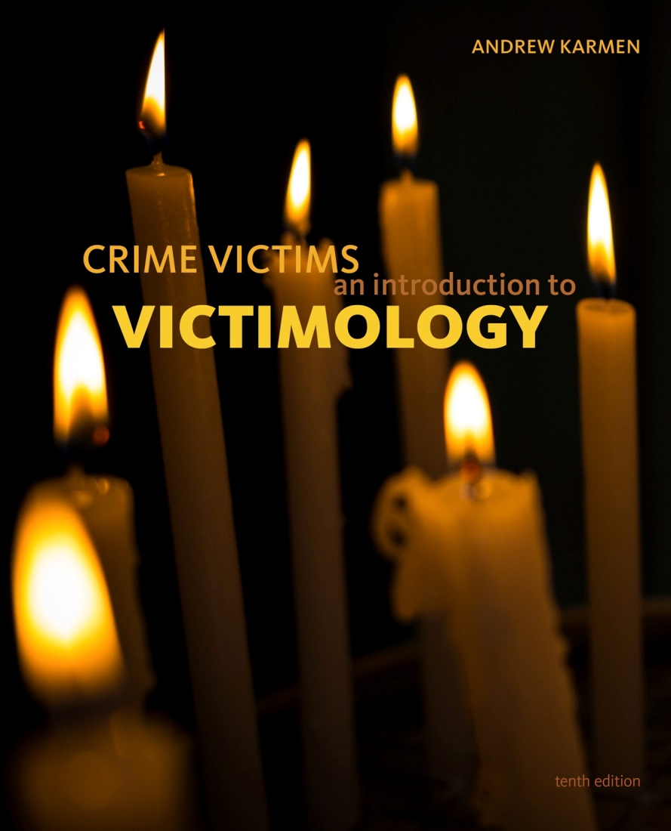

Crime Victims An Introduction to Victimology
Chapter 8
Victimized Children
© 2020 Cengage. All rights reserved.

Slide 2
Learning Objectives (1 of 2)
L01. Contrast the maximalist alarmist and minimalist skeptical perspectives.
L02. Describe the different types of child maltreatment.
L03. Discuss the long-term impact of suffering maltreatment as a child.
L04. Explain the controversy surrounding recalling repressed memories of childhood sexual abuse.
L05. Describe what forms sibling abuse can take.
L06. Define statutory rape.

Slide 3
The ongoing debate Between maximalists and minimalists

Slide 4
Maximalists versus Minimalists
Maximalists
  Warn that an overlooked type of victimization is reaching epidemic proportions
  Tend to be alarmists and assume the worst
Minimalists
  Are skeptical of maximalist claims
  Believe maximalists overestimate and overreact
Best to view the dispute as a result of different information, assumptions, and socioeconomic interests

Slide 5
Missing children

Slide 6
The Rediscovery of the Plight of Kidnapped Children
Demanding ransom or transporting children across state lines is a federal crime
Force is not required
  Abduction can happen via inveiglement
In the 1980s, kidnapping was rediscovered
  Catchphrase missing children
Box 8.1: Highlights of the Rediscovery of the Missing Children Problem

Slide 7
Fears and Confusion Prevails in the Absence of Data
Neither NCVS nor UCR provides data on kidnappings
National Incident Based Record System (NIBRS) tracks kidnappings under “crimes against persons”
Statistical data vary widely
  Different definitions of kidnapping
  Missing children can be runaways, throwaways, or parental abductions

Slide 8
Estimates of the Incidence and Seriousness of the Disappearance Problem (1 of 2)
DOJ funded research projects to clarify definitions, collect data, and generate estimates
“Missing children” categories include
  Stranger abductions with ransom demands
  Short-term kidnappings by nonfamily members
  Family abductions by noncustodial parents
  Runaways, throwaways, and lost children

Slide 9
Estimates of the Incidence and Seriousness of the Disappearance Problem (2 of 2)
2011 NISMART-3 study found four subcategories
  Sexually motivated kidnappings (63 percent)
  Ransom-motivated kidnappings (12 percent)
  Rage-motivated kidnappings (8 percent)
  Intent to keep kidnappings (8 percent)
Box 8.2: How Often Are Children Kidnapped, and What Happens to Them?
Of 105 kidnappings in 2011
  80 percent of captives were girls
  52 percent of the captors were young, single, male strangers

Slide 10
Hunting for Children Who Have Vanished
Before 1990, parents had to prove that their missing child was a victim of foul play
National Child Search Assistance Act of 1990
  Prohibited waiting periods for entering child’s description in the FBI database
National Center for Missing and Exploited Children
  Links agencies
  Operates a hotline and cold case unit

Slide 11
The Amber Alert System
Amber Alerts
  Began in the late 1990s
  “America’s Missing: Broadcast Emergency Response”
  Goal is to rescue children quickly
  Most are nonfamily abductions of nonwhite girls
  Box 8.1: Accomplishments of the Amber Alert System
    2,400 alerts issued
    22 percent led to rescues
    5 percent led to children who perished

Slide 12
Protecting Children from Kidnappers
Children and guardians are educated about
  Stranger danger
  Child lures
Risk-reduction strategies involve
  Homing devices, microchips, fingerprinting, sketch artists
  Code Adam responses in shopping centers
Minimalists note potential social and psychological costs of such measures

Slide 13
Using your critical thinking skills and consider…
Local and national news media report on attempted and completed kidnappings quite often, yet many parents are torn about whether or not to discuss the issue with their children. As a student of victimology, what would you suggest they do?

Slide 14
Physically and sexually abused children

Slide 15
The Rediscovery of Child Abuse (1 of 2)
For centuries, children were parental property
  Excessive discipline could be cruelty to children
House of Refuge movement in early 1800s
Society for the Prevention of Cruelty to Children, 1874
Pediatric radiologists urged legislation against battered child syndrome

Slide 16
The Rediscovery of Child Abuse (2 of 2)
Child Abuse Prevention and Treatment Act, 1974, prohibited
  Neglect
  Physical abuse
  Sexual abuse
  Emotional abuse
Keeping Children and Families Safe Act of 2003
  Broadened the definition of maltreatment to include anything causing serious harm

Slide 17
How Children Suffer
Sexually exploited children are prone to seven groupings of adverse effects
  Affective problems
  Physical repercussions
  Cognitive effects
  Behavioral symptoms
  Self-destructive impulses
  Psychopathological repercussions
  Age-inappropriate sexual knowledge, talk, and involvements

Slide 18
Estimates of the Incidence, Prevalence, and Seriousness of Child Abuse
National Incidence Study (NIS) of Child Abuse and Neglect
  Studies cases investigated by CPS and others
  Maltreatment includes both neglect and abuse
National Child Abuse and Neglect Data System (NCANDS)
  Studies cases investigated by CPS only
  In 2016, CPS estimated 675,000 cases of abuse and neglect

Slide 19
Maximalist versus Minimalist Approaches to the Seriousness of the Problem (1 of 2)
Maximalist arguments
  Abuse is common and should be taken more seriously
  One in four children have been neglected or abused
  Statistics underestimate the true emergency
    Many episodes go unreported
    Many reports are screened and disregarded by agencies
    Abusive punishments are considered the norm in some families

Slide 20
Maximalist versus Minimalist Approaches to the Seriousness of the Problem (2 of 2)
Minimalist views
  Definition of maltreatment has expanded and diluted
  Some abuses are too vague and subjective to guide corrective actions
  Number of unsubstantiated reports are increasing
    Mandatory reporting and heightened public awareness
    Unfounded reports should not be counted
    Some reports (3 percent) are deliberately false

Slide 21
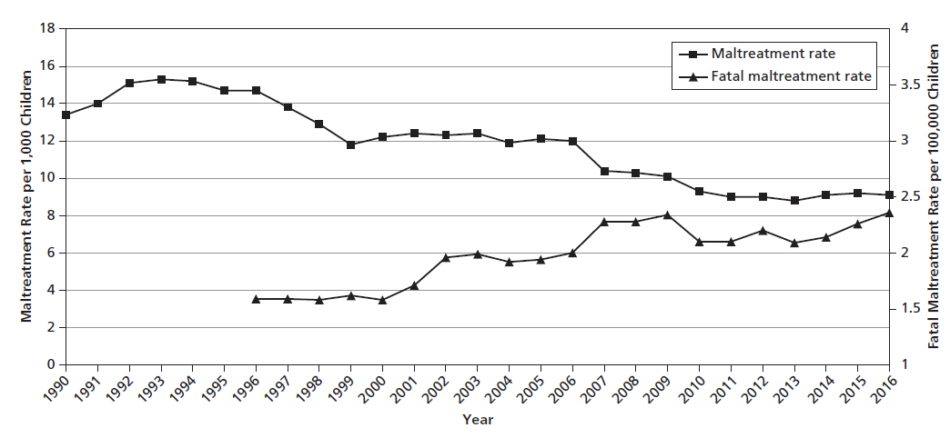
Figure 8.1 Trends in Child Maltreatment Rates, United States, 1990–2016

Slide 22
Differential Risks Children Face of Being Maltreated
NIS and NCANDS data show those facing the highest rates of maltreatment
  Girls
  African-Americans
  Impoverished
  Unemployed parent(s)
  Households of four or more children
  Households with domestic violence
  Rural areas

Slide 23
The Suffering of Sexually Abused Children (1 of 2)
A child is sexually abused when he or she is being used for sexual stimulation of the perpetrator or an observer
  45,000 children were sexually abused in 2016
Four controversies include
  Parent–child incest, especially during custody battles
  Charges of molestation from repressed memories
  Abuse by religious figures, teachers, etc.
  Abuse during religious rituals

Slide 24
The Suffering of Sexually Abused Children (2 of 2)
Accusations made during divorce proceedings and custody battles
  Maximalists argue that incestuous relationships are hidden until parents separate
  Minimalists argue that baseless allegations are taken too seriously
    SAID syndrome
    Goal is for accused parent to lose visitation

Slide 25
The Furor over Recalling Repressed Memories of Childhood Sexual Abuse (1 of 2)
In 1900, Freud believed in repressed memories
In 1980s, memory recovery movement reemerged
Maximalists contended
  Adults use energy to mentally block memories of abuse
  New treatments unblock energies
  Speaking openly helps healing process
Minimalists contend
  Interventions create psuedomemories
  Definitions and symptoms are too vague
Research in the 1990s proved minimalists correct

Slide 26
The Furor over Recalling Repressed Memories of Childhood Sexual Abuse (2 of 2)
Sexual abuse of children by religious figures, teachers, and others in authority
  Accusations began in the 1970s and grew in the 1980s
  Maximalists contend the numbers are higher
    Self-blame and shame causes cases to go unreported
    Civil lawsuits imposed gag orders
    Roman Catholic Church hid abuses
  Minimalists contend
    Many accusers are seeking monetary compensation
    Entire Roman Catholic priesthood is unfairly maligned

Slide 27
Using your critical thinking skills and consider…
In December, 2018, the media noted that more than 78 predator priests had been removed from ministry but were still being paid by the Catholic Church. As part of the laicization process, their new role is a life of prayer and penance. Is this an adequate punishment? Should these men be treated differently than nonreligious abusers?

Slide 28
Allegations of Child Sexual Abuse during Rituals
In the late 1980s and early 1990s, maximalists believed that tens of thousands of people were ritual human sacrifices
  Satanic cults were cannibals
  Many woman had repressed memories
Minimalists insisted that the public was overreacting
  Some were accused of being secret Satanists
  Most thought the media were sensationalists

Slide 29
Abused children And legal proceedings

Slide 30
Taking into Account the Best Interests of the Child
Prevention of further abuse in criminal justice system
Child advocates
  Guardian Ad Litem (GAL)
Two responses to abusers:
  View the parental wrong as dysfunctional and in need of treatment and rehabilitation
  View them as criminals deserving incapacitation and punishment

Slide 31
The Credibility of Children as Witnesses
Skepticism since Salem Witch Trials
Children are immature, creating cognitive limitations
Two points of view
  Pro-prosecution/Pro-victim
    Children are competent witnesses on fairly recent events
  Pro-Defendant
    Testimony is vulnerable to coaching by adults
    High-pressure techniques can lead to false memory and ultimately lead to wrongful conviction
Children are competent witnesses unless proven otherwise

Slide 32
Devising Child-Friendly Practices
States bar courtroom spectators
Limiting case information provided by the media
Sixth Amendment guarantees defendant’s right to confront accusers
  Attorneys block child’s view
  Closed-circuit television and videotape testimonies
Special exceptions to hearsay rule
Anatomically detailed dolls
According to the funnel model, child abuse trials and adult incarceration are rarities

Slide 33
Proactive versus reactive Strategies

Slide 34
Proactive and Reactive Approaches
Proactive approaches include
  Screening childcare workers, training investigators
  Help lines, crisis nurseries, Parents Anonymous groups
  Safe haven laws
Reactive approaches
  Question the role of government in social nurturance and social control
  View children as junior citizens

Slide 35
Additional forms of exploitation and mistreatment of young people

Slide 36
Sibling Abuse
Most frequent, yet least studied form of assault
Sons are more violent than daughters
Common in all-boy families
Younger child tends to silence

Slide 37
Abuse of Adolescents by Parents
Difficult to measure because considered discipline
Adolescents not viewed as vulnerable or defenseless
Sons who strike back are often charged with assault
Daughters often respond by running away, becoming sexually active, or taking drugs

Slide 38
Statutory Rape of Minors
Often overlooked due to absence of data and presence of willing victims
95 percent of cases fit the stereotype
  Exploitive older males taking advantage of teenage girls

Slide 39
Things to Consider
The Maximalist vs the Minimalist views. Is there an in between or do you have to be one or the other?
How has the concept and reaction to “missing children” changed over time?
How do authorities distinguish between false or fabricated allegations versus the truth?

